Slide 1
بسم الله الرحمن الرحيم

Slide 2
Epithelium
By
Dr: Doha Saber Mohamed

Slide 3
Characteristic features and basement membrane
Closely packed cells with little extracellular material
Many cell junctions often provide secure attachment.
Cells sit on basement membrane
Apical (upper) free surface
Basal surface against basement membrane
A vascular---without blood vessels
nutrients and waste must move by diffusion
Good nerve supply
Rapid cell division (high mitotic rate)
Functions
protection, filtration, lubrication, secretion, digestion, absorption, transportation, excretion, sensory reception, and reproduction.

Slide 4
Types of Epithelium
Covering and lining epithelium
epidermis of skin
lining of blood vessels and ducts
lining respiratory, reproductive, urinary & GI tract
Glandular epithelium
thyroid, adrenal, and sweat gland
Neuroepithelium
Germinal epithelium

Slide 5
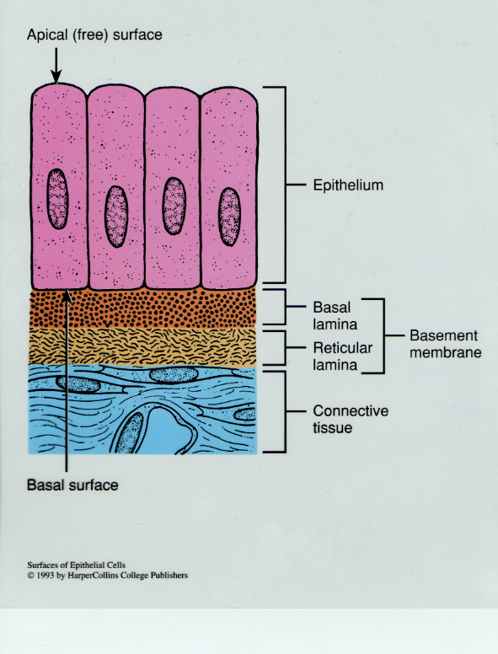
Typical Arrangement
of Epithelial Tissue and its Basement Membrane

Slide 6
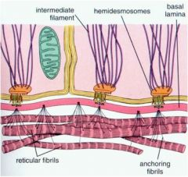

Slide 7
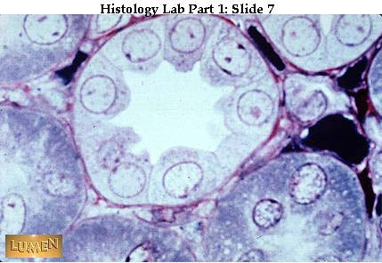
Typical Microscopic View of Epithelial Cells
and its Basement Membrane
Basement membrane

Slide 8
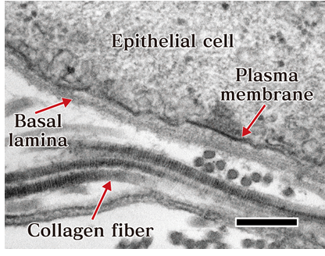

Slide 9
Function of basement membrane
1-Mechanical support to the epithelial cells.
2-In case of injury, it acts as a substrate that guides the migration of new cells from the margins of the wound to restore epithelial continuity.
3-Act as a molecular sieve or ultrafilter as in the basement membrane of the glomeruli of the kidney.
4-It regulates exchanges of macromolecules between C.T. and other tissues.
5-It influences the cell polarity, regulates cell proliferation and differentiation, influences cell metabolism and organizes the proteins in adjacent plasma membrane.

Slide 10
MCQ

Slide 11
1- Epithelium :
a- they line body surfaces b- they are vascular c- they have basal lamina
d- they contain relatively large amounts of intercellular substance
e-both a&c.
2- Epithelium
a-is composed of cells and few fibers b-contains blood capillaries
c-has many functions depending on its site d-can not regenerate
e-provides support for organs

Slide 12
3- The general characteristics of epithelial cells are all the following except:
a-intercellular substance is nearly absent
b- all the cells in the basal layer are resting on a basement membrane.
c- nerve fibers and blood vessels can pass within epithelial cells
d- endoderm, ectoderm and mesoderm can share in formation of epithelium
e- most epithelial cells have the ability of regeneration
- Basement membrane :
a- Consists of a single layer of flattened cells. b- Contain type I collagen fibers .
c- A cellular. d- can be demonstrated by PAS . e- both b & d

